Slide 1
Design and Analysis of Algorithms
Midterm Revision

Slide 2
Trees
Binary Search Trees (BST)
AVL Trees (AVL)
Red Black Trees (RB)
A tree problem may ask you to:
Identify if the tree is BST or not, AVL or not, RB or not.
Insert a sequence of keys (K1, K2, K3, …, KN) for each type of trees.
Delete a key or two from the tree.

Slide 3
Binary Search Trees
Q1) Insert 8, 10, 3, 14, 1, 6, 4, 13, 7 in an empty BST.

Slide 4
Binary Search Trees
Q1) Insert 8, 10, 3, 14, 1, 6, 4, 13, 7 in an empty BST.
Q2) Delete 14 and 8 from the binary search tree.
Q3) What is the time complexity for:
Searching in BST
Insertion in BST
Deletion in BST

Slide 5
BST Trees
Q4) What is the advantage of Hashing Tables over BST?
Hash Table supports following operations in Θ(1) time. 1) Search 2) Insert 3) Delete
The time complexity of above operations in a self-balancing Binary Search Tree (BST) (like RB Tree, AVL Tree, Splay Trees, etc) is O(log n).
So Hash Table seems to beating BST in all common operations.

Slide 6
BST Trees
Q5) What is the advantage of BST over Hashing Tables?
We can get all keys in sorted order by just doing in-order traversal of BST. This is not a natural operation in Hash Tables and requires extra efforts.
BSTs are easy to implement compared to hashing, we can easily implement our own customized BST. To implement hashing, we generally rely on libraries provided by programming languages.
With Self-Balancing BSTs, all operations are guaranteed to work in O(log n) time. But with Hashing, Θ(1) is average time and some particular operations may be costly, especially when table resizing happens.

Slide 7
BST Trees
Q6) Do a preorder Traversal (Root – Left – Right)
8, 3, 1, 6, 4, 7, 10, 14, 13
Q7) Do an in-order Traversal (Left – Root – Right)
1, 3, 4, 6, 7, 8, 10, 13, 14
Q8) Do a post-order Traversal (Left – Right – Root)
1, 4, 7, 6, 3, 13, 14, 10, 8

Slide 8
AVL Trees
Q9) Which is AVL and which is not AVL tree?

Slide 9
AVL Trees
Q10) What is the advantage of AVL trees over binary search trees?

Slide 10
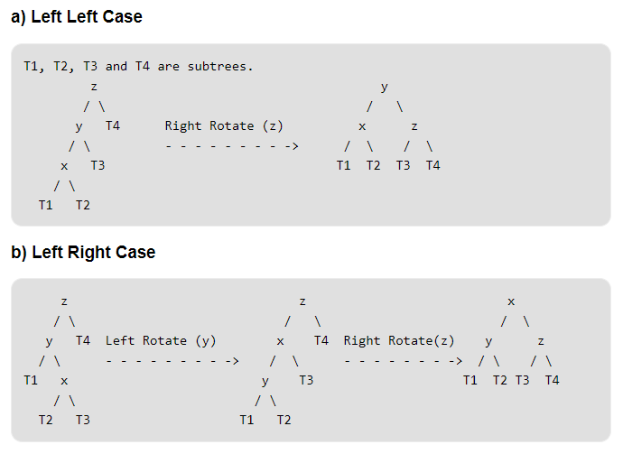
AVL Trees
z is the first unbalanced node.
y and x are the child and grandchild of z respectively on the path to w (the newly inserted node).

Slide 11
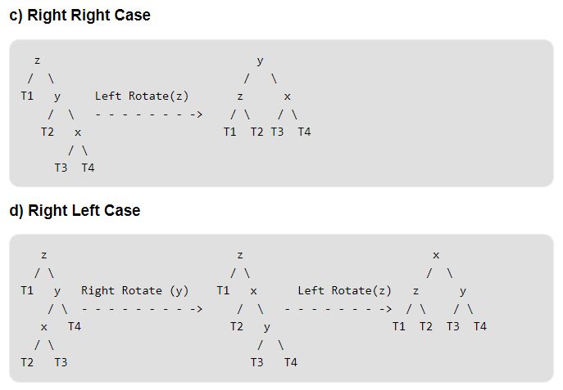
AVL Trees
z is the first unbalanced node.
y is the child of z.
x is the grandchild of z.
Both y and x are on the path to w (the newly inserted node).

Slide 12
AVL Trees
See example on insertion.

Slide 13
AVL Trees (Deletion)
Same rotation applies but different notation:
z is the first unbalanced node.
y is the larger height child of z.
x is the larger height child of y.

Slide 14
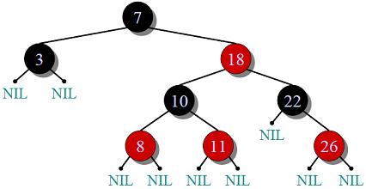
Red Black Trees
Very Important Notes:
Every node is either RED or BLACK.
The root of the tree is always BLACK.
There are NO two adjacent RED nodes (A RED node cannot have a RED parent or RED child).
Every path from a node (including root) to any of its descendant NULL node has the same number of BLACK nodes.

Slide 15
Red Black Trees
Q11) Prove that a red-black tree must be self balancing for a 3-node tree.
Q12) Define Black Height of a Red-Black Tree to be: Black height is number of black nodes on a path from a node to a leaf. Leaf nodes are also counted black nodes.
What is the black height of a node of height h?

Slide 16
Red Black Trees
Q13) AVL vs RB Trees
Binary Search Trees | AVL Trees | RB Trees
Not Self Balancing | Self Balancing More balanced than RB Trees | Self Balancing
Might perform poorly in case of skewed BST (i.e. O(n)) | Guaranteed to work on all operations in O(log n) | Guaranteed to work on all operations in O(log n)
 | Preferred when search operations are more frequent than insertions and deletions. | Preferred when insertions and deletions are more frequent in your application.
 | Depends only on rotations | Depends on rotations and recolouring.

Slide 17
Red Black Trees
Q15) True or False?
A red black tree can be all black nodes.
Q16) Give an example for Red Black Tree that’s not AVL Tree.
Q17) True or False? The height of an AVL Tree is guaranteed to be less than (in general) to the height of the RB Tree.

Slide 18
Red Black Trees
Insertion:
Let x be the newly inserted node.
Perform standard BST insertion and make the color of newly inserted nodes as RED.
If x is the root → Change its color to BLACK.
If x is not the root:
Case I: x’s parent is BLACK → DONE! ☺
Case II: x’s parent is RED → ☹ A. Case A: x’s uncle is RED → Change PARENT & UNCLE to BLACK → Let x = x’s grandparent and repeat (1) B. Case B: x’s uncle is BLACK → Perform ROTATIONS with COLOR SWAPS.

Slide 19
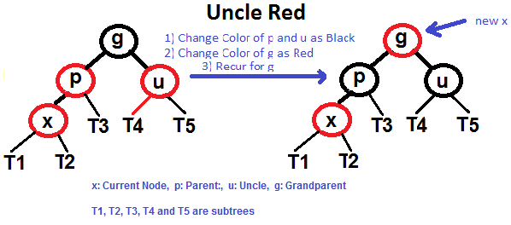
Red Black Trees

Slide 20
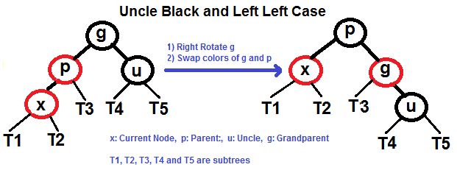
Red Black Trees

Slide 21
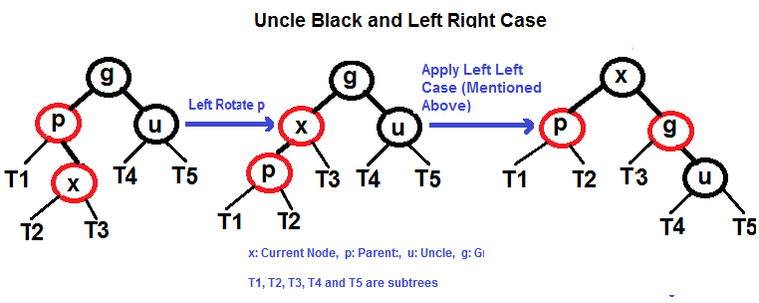
Red Black Trees

Slide 22
Red Black Trees
Q18) Insert 10, 20, 30 and 15 in an empty tree
Q19) Insert 2, 6 and 13 in the below tree

Slide 23
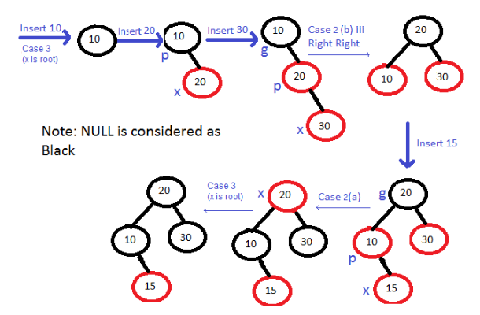
Red Black Trees
Q18) Insert 10, 20, 30 and 15 in an empty tree

Slide 24
Red Black Trees
Q18) Insert 10, 20, 30 and 15 in an empty tree

Slide 25
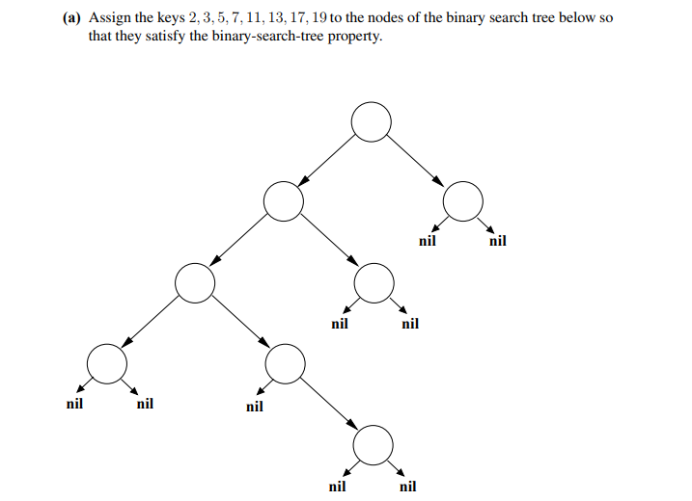
Q19)

Slide 26
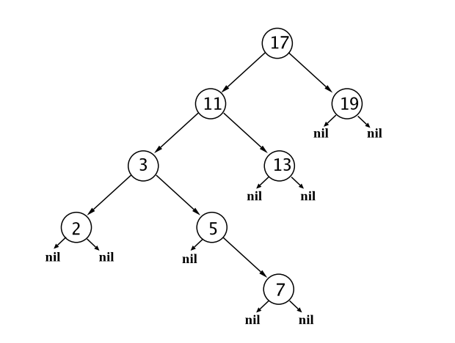
Q20) Explain why this binary search tree cannot be colored to form a legal red-black tree

Slide 27
Q21) The binary search tree can be transformed into a red-black tree by performing a single rotation.
Draw the red-black tree that results, labeling each node with “red” or “black.” Include the keys from part (a)

Slide 28
Q21) The binary search tree can be transformed into a red-black tree by performing a single rotation.
Draw the red-black tree that results, labeling each node with “red” or “black.” Include the keys from part (a)

Slide 29

Q22) Solve the following recurrences:
$T\left(n\right)=2T\left(\frac{n}{8}\right)+\sqrt[3]{n}$
$T\left(n\right)=T\left(n−1\right)+n$
$T\left(n\right)=2T\left(\sqrt{n}\right)+\lg{n}$
$T\left(n\right)=T\left(\frac{3n}{4}\right)+T\left(\frac{n}{4}\right)+n$

Slide 30
Q23)For each of the following algorithms:
a) Give a recurrence that describes its worst-case running time. b) Give its worst case running time using theta notation.
Binary Search
Insertion Sort
Merge Sort

Slide 31

Q23) Suppose we use a hash function $h$to hash $n$ distinct keys into an array $T$ of length $m$. Assuming simple uniform hashing, the expected number of colliding pairs of elements is $θ(\frac{n^{2}}{m})$.

